Slide 1
Network Intrusion Detection System
Team Members:-
Ekom Singh Bagga (2019249)
Tanay Chaturvedi (2019350)
Aman Pandey (2019201)
Himanshu Singh (2019266)
Rishav Kumar (2019130)
Dr. Abhishek Verma

Slide 2

What is Intrusion Detection System?
A monitoring system called an intrusion detection system (IDS) looks for abnormal activity and sends out alarms/alerts when it does.
A security operations centre (SOC) analyst or incident responder can analyse the problem and take the necessary steps to eliminate the threat based on these alerts.

Slide 3
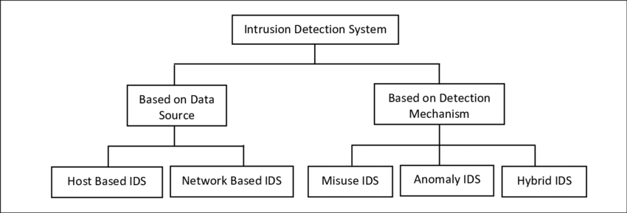
Types of Intrusion Detection System

Slide 4
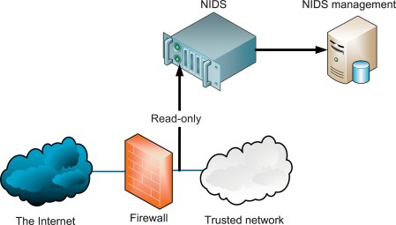
Network Based Intrusion Detection System
Network-based intrusion detection systems (NIDS) are devices intelligently distributed within networks that passively inspect traffic traversing the devices on which they sit.
NIDS can be hardware or software-based systems and, depending on the manufacturer of the system, can attach to various network mediums such as Ethernet, FDDI, and others.

Slide 5

Statistical based Anomaly Detection System
Anomaly-based IDSs typically work by taking a baseline of the normal traffic and activity taking place on the network. They can measure the present state of traffic on the network against this baseline in order to detect patterns that are not present in the traffic normally.

Slide 6
Introduction
Network Intrusion Detection System is a python program that reads captured network packets, assemble the tcp streams and detect attacks based on given signature database. It is developed with keeping memory constrained to 256mb to prevent Denial of Service Attack. It also performs IPv4 and TCP checksum to validate the packet's integrity.

Slide 7
Specification
This Network Intrusion Detection System processes PCAP Files to detect attack using a signature database provided in TOML format. Each signatures in the file are regular expression over byte strings and are matched against IP datagram payloads and TCP streams.

Slide 8
Following is the structure of the TOML Signature Database file:
signatures = [
"foo",
"bar[0-9]+",
"pwned_[a-zA-Z_]+_grade"
]

Slide 9
Features
IPv4 and TCP checksum verification failing to which packets are dropped silently
Custom TCP stream reassembly implementing a first-received policy for overlapping segments
Do not track TCP sessions where initial TCP handshake was not observed
Bounded memory use during execution to prevent DoS attacks using Buffer Trimming

Slide 10
Logging Detection
Detections are printed to stdout as individual JSON objects, one per line.
The format of a single detection is as follows.
{
"tv_sec": 1600890293, # Packet timestamp seconds (since UNIX epoch)
"tv_usec": 0, # Packet timestamp microseconds field
"source": {
"ipv4_address": "10.0.0.1", # Source IPv4 address
"tcp_port": 34567 # Source TCP port, or null if N/A
},

Slide 11
"target": {
"ipv4_address": "10.0.0.2", # Target IPv4 address
"tcp_port": 1234 # Target TCP port, or null if N/A
},
"attack": 0 # Signature index in database (0-indexed)
}

Slide 12
Thank
You

